Slide 1
Forecasting Analytics
Session 10

Slide 2
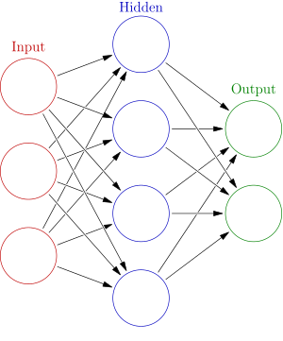
Neural networks
Black-box model
Input-output relation is governed by layers of inter-connected processing elements (‘neurons’).
Weighted combination of output of one layer is fed as input to next layer.
There can be one or more hidden layers.
Weights are updated recursively to make the ‘network’ learn to produce output close to ‘ideal’ output.
This is done through ‘training data’.
Output can be continuous or binary.
No error estimate is available.

Slide 3


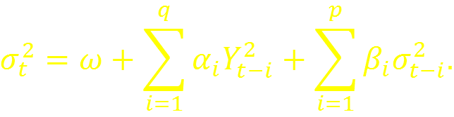
ARCH and GARCH models
ARCH(q) model
GARCH(p,q) model
These models seek to incorporate volatilities observed in certain time series
stock prices
exchange rate

Slide 4
Bootstrap in forecasting
What it is
A way of specifying pattern of errors associated with estimation, prediction, etc.
How it works
Errors arise from sample-to-sample variation.
Multiple sets of artificial data are created by ‘re-sampling’ from the available data.
Chosen procedure is repeated with artificial samples.
Variation in outcome is measured and specified.
When it is used
When model-based specification is unreliable.
When theoretical calculations are difficult.

Slide 5
Further reading
Growth models – Michael K. Evans (2002), Practical Business Forecasting, Blackwell, Section 10.2.
Logistic regression – Kieth Ord (2011), Principles of Business Forecasting, 1st Edition, Cengage Learning, Section 10.3.
Neural networks – G. Peter Zhang (2003), Neural Networks in Business Forecasting, Information Science Publishing; Douglas C. Montgomery, Cheryl L. Jennings and Mutar Kulahci (2008), Introduction to Time Series Analysis and Forecasting, Wiley, Section 7.7.
ARCH/GARCH – Douglas C. Montgomery, Cheryl L. Jennings and Mutar Kulahci (2008), Introduction to Time Series Analysis and Forecasting, Wiley, Section 7.3.

Slide 6
Common sense in forecasting
A range of methods have been taught and illustrated
How a method is to be used may be governed by
The circumstances of data collection
Domain knowledge
Outcome of initial analysis
The analyst’s ability to pick up patterns from a plot
Two examples…

Slide 7
Forecast: Energy usage for Washington Water power (1980-1996)
Forecast is in line with past experience

Slide 8
Forecast: Energy usage for Washington Water power (1980-1996)
Is forecast in line with past experience of Q3?

Slide 9
The Chicken-egg story
chicken: number of chickens (December 1 population of all US chickens excluding commercial broilers),
egg: number of eggs (US egg production in millions of dozens).

Slide 10
Chicken-egg scatter plot
The two series appear to have similar twists and turns
Yet the scatter plot shows no clear relation

Slide 11
Chicken-egg meeting point
Scatter plot of the two series shows no clear relation
Yet the scatter plot of the differenced series show a pattern

Slide 12
To summarize
Learning Forecasting Analytics is different from learning to drive a car.
There may be different ways to answer a single question.
Essentials
Knowledge of tools,
Awareness of pitfalls,
Lots of practice .
A dependable step-by-step guide may be elusive.
Learning from examples is not unscientific. That’s the way we all learnt our first language!

